Slide 1

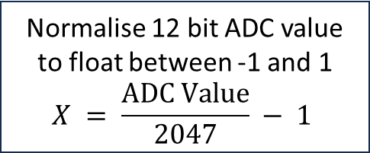
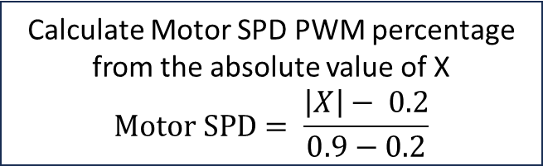

Start
Initialise variables and peripherals
Update outputs
For each motor
Normalise 12 bit ADC value to float between -1 and 1
$$X = \frac{ADC Value}{2047} − 1$$
Calculate Motor SPD PWM percentage from the absolute value of X
$$Motor SPD= \frac{\left|X\right|− 0.2}{0.9−0.2}$$
Is
$$X > 0.2$$
?
Yes
Motor FWD = 1
Motor REV = 0
motor moves forward
No
Is
$$X < 0.2$$
?
Yes
Motor FWD = 0
Motor REV = 1
motor moves backwards
No
Motor FWD = 0
Motor REV = 0 motor shuts off

